Slide 1
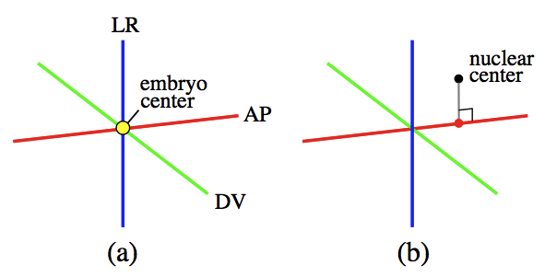
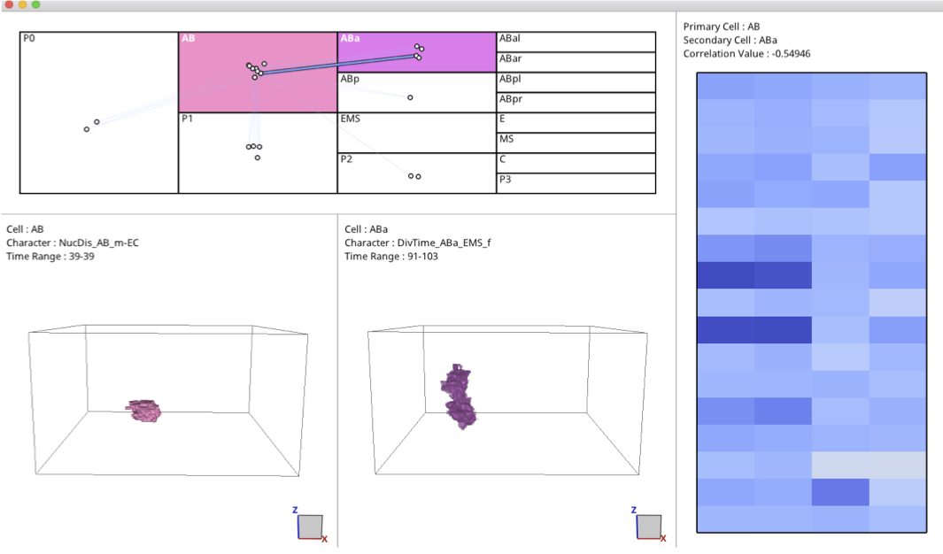
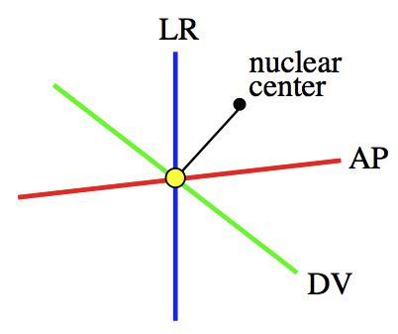
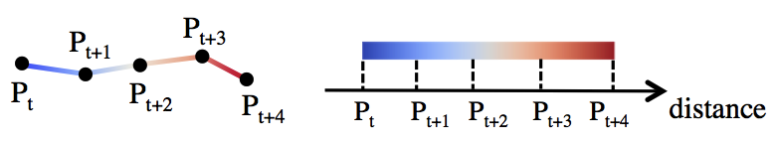
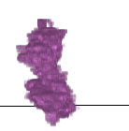
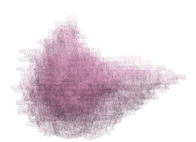
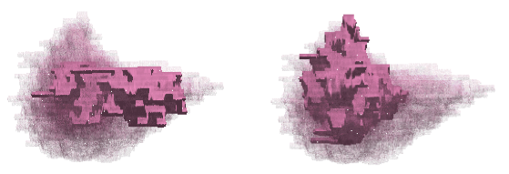
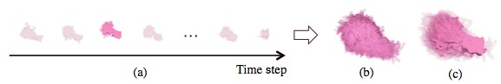

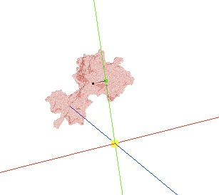
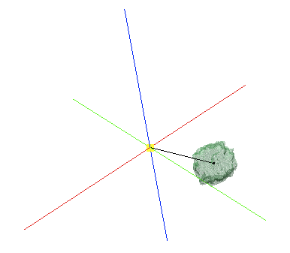
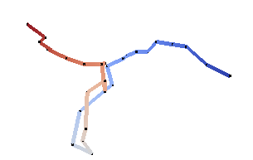
Cell nucleus visualization
with phenotypic characteristics
Sayaka Nagai, Naohisa Sakamoto（Kobe University）
Koji Kyoda, Shuichi Onami（Laboratory for Developmental Dynamics, RIKEN Quantitative Biology Center）
Introduction
Visualizatioin of phenotypic characteristic
Developmental mechanism of C.elegans.
Nuclear position
Draw AP, DV, LR axes.
Plot an embryo and
a nuclear center.
Draw the foot of the
perpendicular.
Phenotypic characteristic
ー Spatiotemporal features
of a cell.
(ex. Cell nuclear position,
movement distance)
Distance between nuclear center and emryo center
Connect a nuclear center and an embryo center.
Cell nucleus
visualization
Time:91-103 → an average cell nucleus shape
(from 91 to 103)
Problem
When a phenotypic characteristic exists over multiple time,
an average shape is visualized.
→We cannot observe an individual shape.
It is difficult to grasp position or distance
only from a cell nucleus shape.
Movement distance of a cell nucleus
Connect cell nuclear centers.
(P_{t} is the position of a cell nucleus at the time step t.)
→A cell nucleus moves from blue to red.
Objective
Result
Visualization of cell nuclei having a phenotypic
characteristic appearing over multiple time steps.
Showing phenotypic characteristics(position, distance).
Visualizatioin of 3D cell nuclei
"Movement distance of AB nucleus” (27 time steps)
Method
overview
t=3
t=23
Visualizatioin of 3D cell nuclei
Visualizatioin of phenotypic characteristic
A cell nucleus shape with
phenotypic chatacteristics
changes over time.
"DV position of
ABp nucleus"
"Distance between
nuclear center and
EMS embryo center"
"Movement distance
of AB nucleus"
An overview shape
All the cell nuclei are overlapped
with an opacity .
Select a cell nucleus
Discussion
An highlighted shape
A selected cell nucleus → Opaque
Other ones → Semitransparent
We could draw a cell nucleus shape individually and display position and distance.
We should draw not only a trajectory but a straight line which represents length of a movement distance.
PacificVis 2018 Poster

